Slide 1
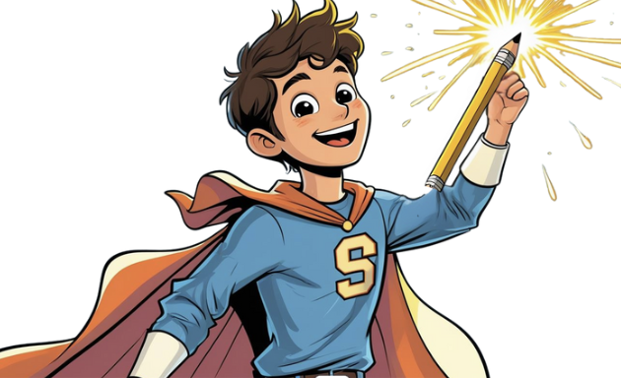
An Introduction to the POWER Writing Strategy
You have the POWER
to be a Great Writer!
Barks a lot
Golden fur
Loves to play
My dog Max

Slide 2
What is the POWER Strategy?
The POWER strategy is a 5-step process that helps you become more confident and effective writing. Each letter in POWER stands for a step in the writing process.

Slide 3

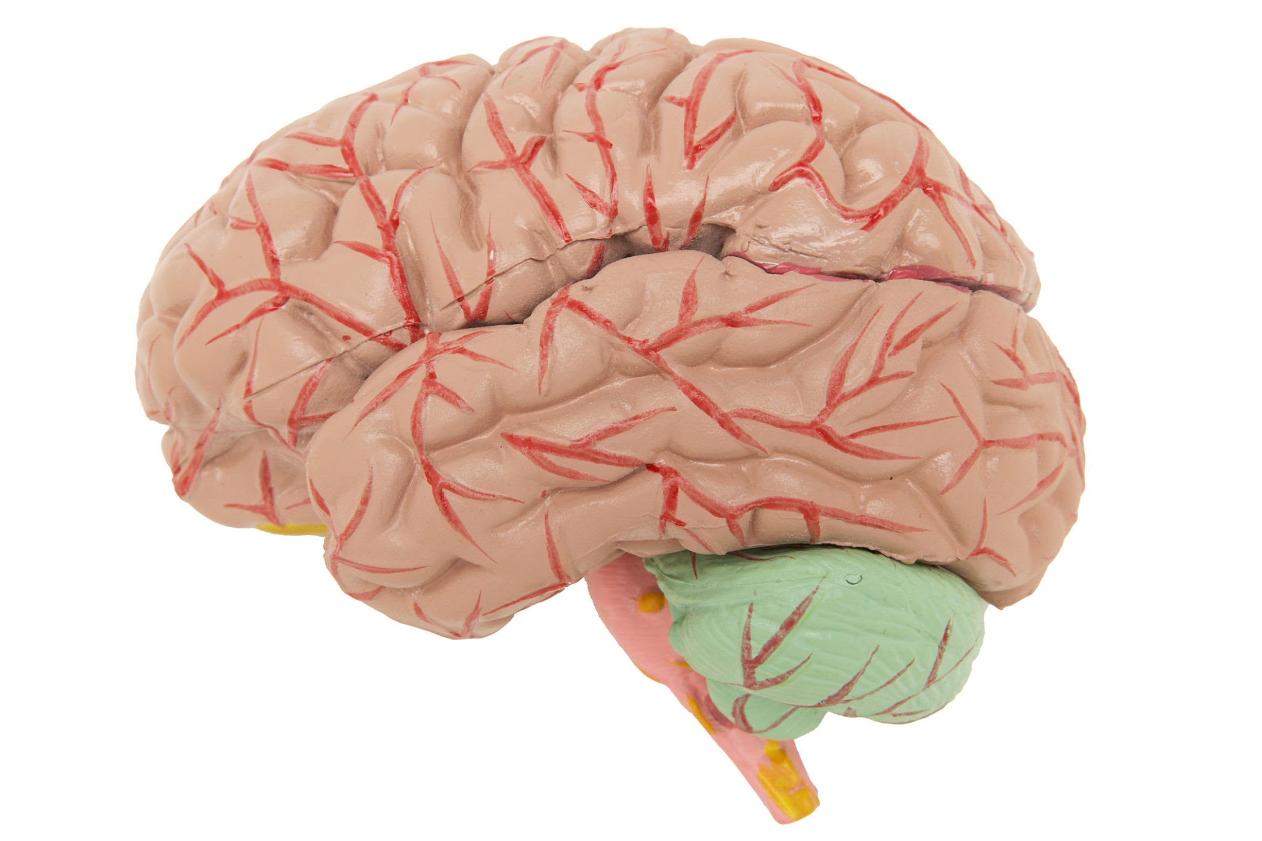



What is the POWER Strategy?
P | Plan
O | Organize
W | Write
E | Edit
R | Revise

Slide 4


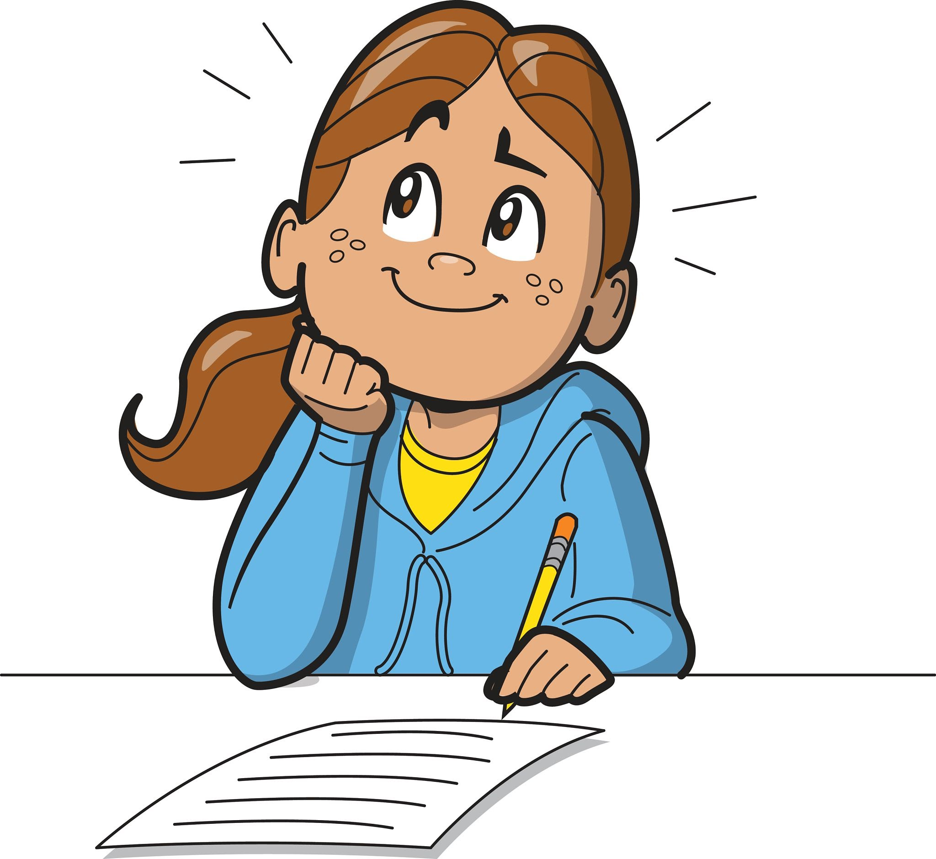
P is for Plan: Unleash Your Ideas! (Part 1)
Before you start writing, you need a plan! This is where you brainstorm and let your creativity shine.
What’s your topic?
Decide what you are going to write about.

Slide 5
P is for Plan: Unleash Your Ideas! (Part 2)
Brainstorm!
Think of all the ideas that connect to your topic. No idea is a bad idea at this stage!
Who are you writing for?
Think about your audience. Are you writing for your teacher, your friends or your family?

Slide 6
O is for Organize: Get Your Thoughts in Order!
Your Organized Outline
Topic: My Dog, Max
What he looks like:
Golden fur
Floppy ears
How he acts:
Friendly
Wags his tail
Barks a lot
Loves to play fetch
Your Brainstorm
Barks a lot
Golden fur
Loves to play fetch
My dog Max
Wags his tail
Friendly
Has floppy ears

Slide 7

W is for Write: Let the Words Flow!
This is your first draft, also known as the “sloppy copy.” The most important thing is to get your ideas down.
Don’t worry about mistakes! This is no the time to be perfect
Focus on getting your thoughts from your brain to the page.
Write, write, write! Keep you pen moving, or your fingers typing.

Slide 8

E is for Edit: Time to be a Word Detective! (Part 1)
Now it’s time to put on your detective hat and look for clues…
to make your writing better!
I fownd a kute dog!

Slide 9
E is for Edit: Time to be a Word Detective! (Part 2)
Use CUPS to guide you:
C - Capitalization: Are all your sentences and proper nouns capitalized?
U - Usage: Does everything make sense? Are you using the right words?
P - Punctuation: Do you have periods, question marks, and commas in the right places?
S - Spelling: Are there any misspelled words?

Slide 10
R is for Revise: Make Your Writing Even Stronger! (Part 1)
The dog was happy.
Revising is different from editing.
It’s about improving the content and flow of your writing.
The fluffy, golden retriever wagged its tail.

Slide 11
R is for Revise: Make Your Writing Even Stronger! (Part 2)
Use CUPS to guide you:
C - Capitalization: Are all your sentences and proper nouns capitalized?
U - Usage: Does everything make sense? Are you using the right words?
P - Punctuation: Do you have periods, question marks, and commas in the right places?
S - Spelling: Are there any misspelled words?

Slide 12

You have the POWER!
Congratulations!
You’ve learned the POWER writing strategy. Remember, writing is a process, and every great writer uses these steps to create amazing work.
Keep practicing, and you’ll become a writing superhero.

