Slide 1

Revising with the
CDO Writing Strategy
Compare, Diagnose, Operate

Slide 2
What is the purpose of revising?
  Evaluate your own writing, focusing on clarity, coherence, structure, and audience alignment
  Gain metacognitive awareness by articulating intended meaning versus expressed text
  Empower self-regulation during revision through structured decision-making

Slide 3
What is CDO?
CDO Stands For: Compare, Diagnose, Operate
  Compare: Students read their writing sentence by sentence, comparing what they intended to express with the actual text

Slide 4
What is CDO? (Part 2)
Compare, Diagnose, Operate
  Diagnose: They pinpoint issues, such as unclear meaning, awkward phrasing, mis-sequencing, weak development, or drift from the main idea. They are guided by evaluation cards for clarity, audience, and purpose

Slide 5
What is CDO? (Part 3)
Compare, Diagnose, Operate
  Operate: Students choose and apply revision tactics (e.g., adding detail, deleting extraneous content, rewording, or reorganizing text) to edit and improve their writing

Slide 6
Steps for CDO Strategy (Part 1)
Step | Action | Guiding Question
Compare | Read one sentence. Think: "Is this what I meant to say?" | Does this match my idea?
Diagnose | Identify issues: ambiguity, missing context, shaky structure, drift from main idea | What doesn’t sound clear or effective?

Slide 7
Steps for CDO Strategy (Part 2)
Step | Action | Guiding Question
Operate-Identify Tactic | Choose a revision method: add, delete, rewrite, or reorder text | What can I do to fix it?
Operate-Revise | Apply the chosen tactic. Re-read to confirm improved alignment | Does this now convey my intention clearly?

Slide 8
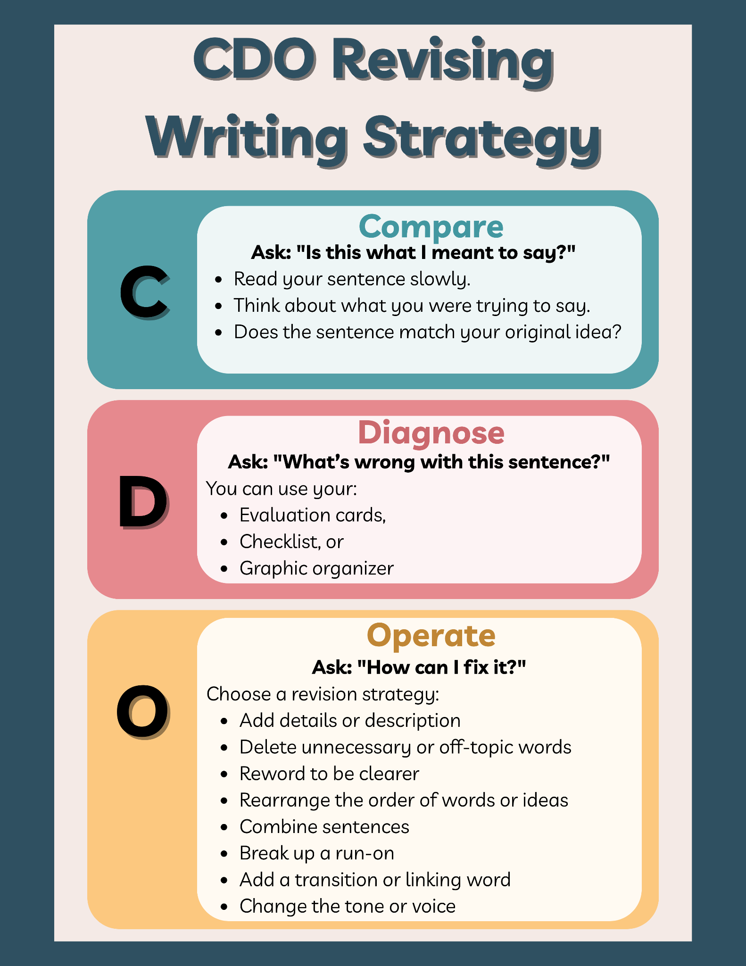

Slide 9
CDO Evaluation Cards
Step 2: Diagnose
“This is not what I intended to say.”
“This is good!”
“This is not useful to my paper.”
“This doesn’t sound right.”

Slide 10
CDO Evaluation Cards (Cont.)
Step 2: Diagnose
“The reader may not understand this.”
“The reader won’t believe this.”
“The reader won’t be interested in this.”
“The reader will understand and believe this.”

Slide 11
Step 3: Operate | How to fix sentences
Add Descriptive Detail
Enhance your writing by including adjectives, adverbs, sensory language, or specific examples
Example: "The dog barked." → "The scruffy brown dog barked loudly at the passing mail truck."

Slide 12
Step 3: Operate | How to fix sentences
Delete Redundant or Off-Topic Words
Remove unnecessary words that clutter or detract from the main idea
Example: "I actually really, really enjoyed the awesome, fun game." → "I enjoyed the game."

Slide 13
Step 3: Operate | How to fix sentences
Reword for Clarity or Precision
Replace vague or confusing language with more specific or appropriate vocabulary
Example: "She did stuff at the event." → "She organized the community booths at the event."

Slide 14
Step 3: Operate | How to fix sentences
Rearrange Sentence Structure
Change the order of words or phrases to improve flow, coherence, or emphasis
Example: "In the forest, a bear I saw." → "I saw a bear in the forest."

Slide 15
Step 3: Operate | How to fix sentences
Combine Sentences
Merge short, choppy sentences into one sentence to improve fluency and reduce repetition.
Example: "I went to the store. I bought apples." → "I went to the store and bought apples."

Slide 16
Step 3: Operate | How to fix sentences
Break Up a Run-On Sentence
Divide a long, confusing sentence into two or more clear, complete sentences
Example: "We ran all the way to the park it was really far and I got tired." → "We ran all the way to the park. It was really far, and I got tired."

Slide 17
Step 3: Operate | How to fix sentences
Add a Transition or Linking Phrase
Improve coherence between ideas by inserting a word or phrase that signals relationships
Example: "I didn’t study. I passed the test." → "Even though I didn’t study, I passed the test."

Slide 18
Step 3: Operate | How to fix sentences
Change the Tone or Voice
Modify the language to better suit the audience or purpose (e.g., more formal, more engaging)
Example: "Whatever, I just did it." → "Despite my hesitation, I completed the task."

Slide 19
Now You Try!
Class Practice Prompts | See Handout
Prompt: A Moment I’ll Never Forget
Think about a moment in your life that stands out, whether it was joyful, embarrassing, exciting, or scary. Describe what happened. Who was there? why did it stick with you?
  Great for: Revising emotional tone, adding descriptive details, clarifying events

Slide 20
Now You Try!
Class Practice Prompts | See Handout
Prompt: If I Were in Charge of the School for a Day
What would you change, and why? Describe your schedule, rules, and activities.
  Great for: Rewording vague ideas, organizing sequences, and strengthening voice.

Slide 21
Now You Try! (Part 3)
Class Practice Prompts | See Handout
Prompt: The Day Everything Went Wrong
Write a true or fictional story about a day when nothing seemed to go as planned. How did you respond?
  Great for: Adding transitions, combining sentences, and using sensory language.

Slide 22
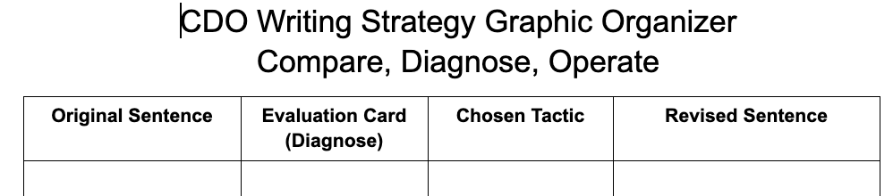
Graphic Organizers to Support the Revision Process

Slide 23
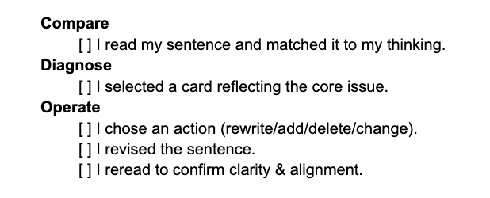
Graphic Organizers to Support the Revision Process
CDO Writing Strategy Checklist Document

Slide 24
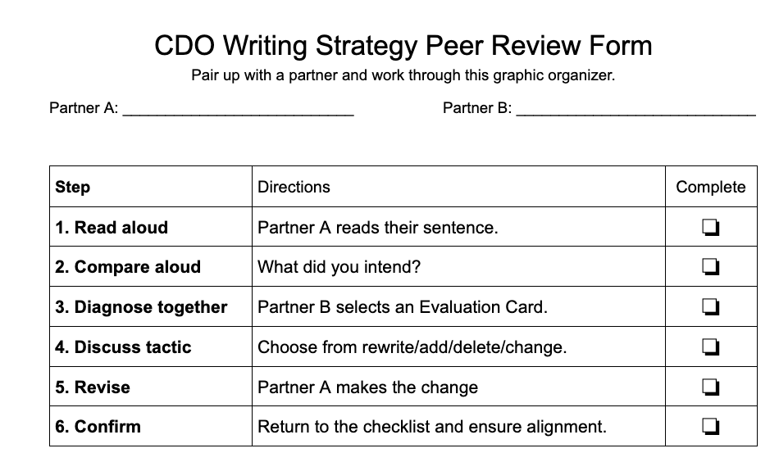
Graphic Organizers to Support the Revision Process

